Slide 1

R-ticulating Data
A Tech Taco Presentation by
Jeremy R. Groves, Ph.D.
Department of Economics
March 4, 2025
https://github.com/jrgroves/Rticulate

Slide 2

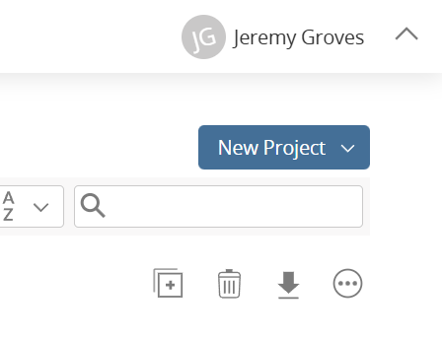
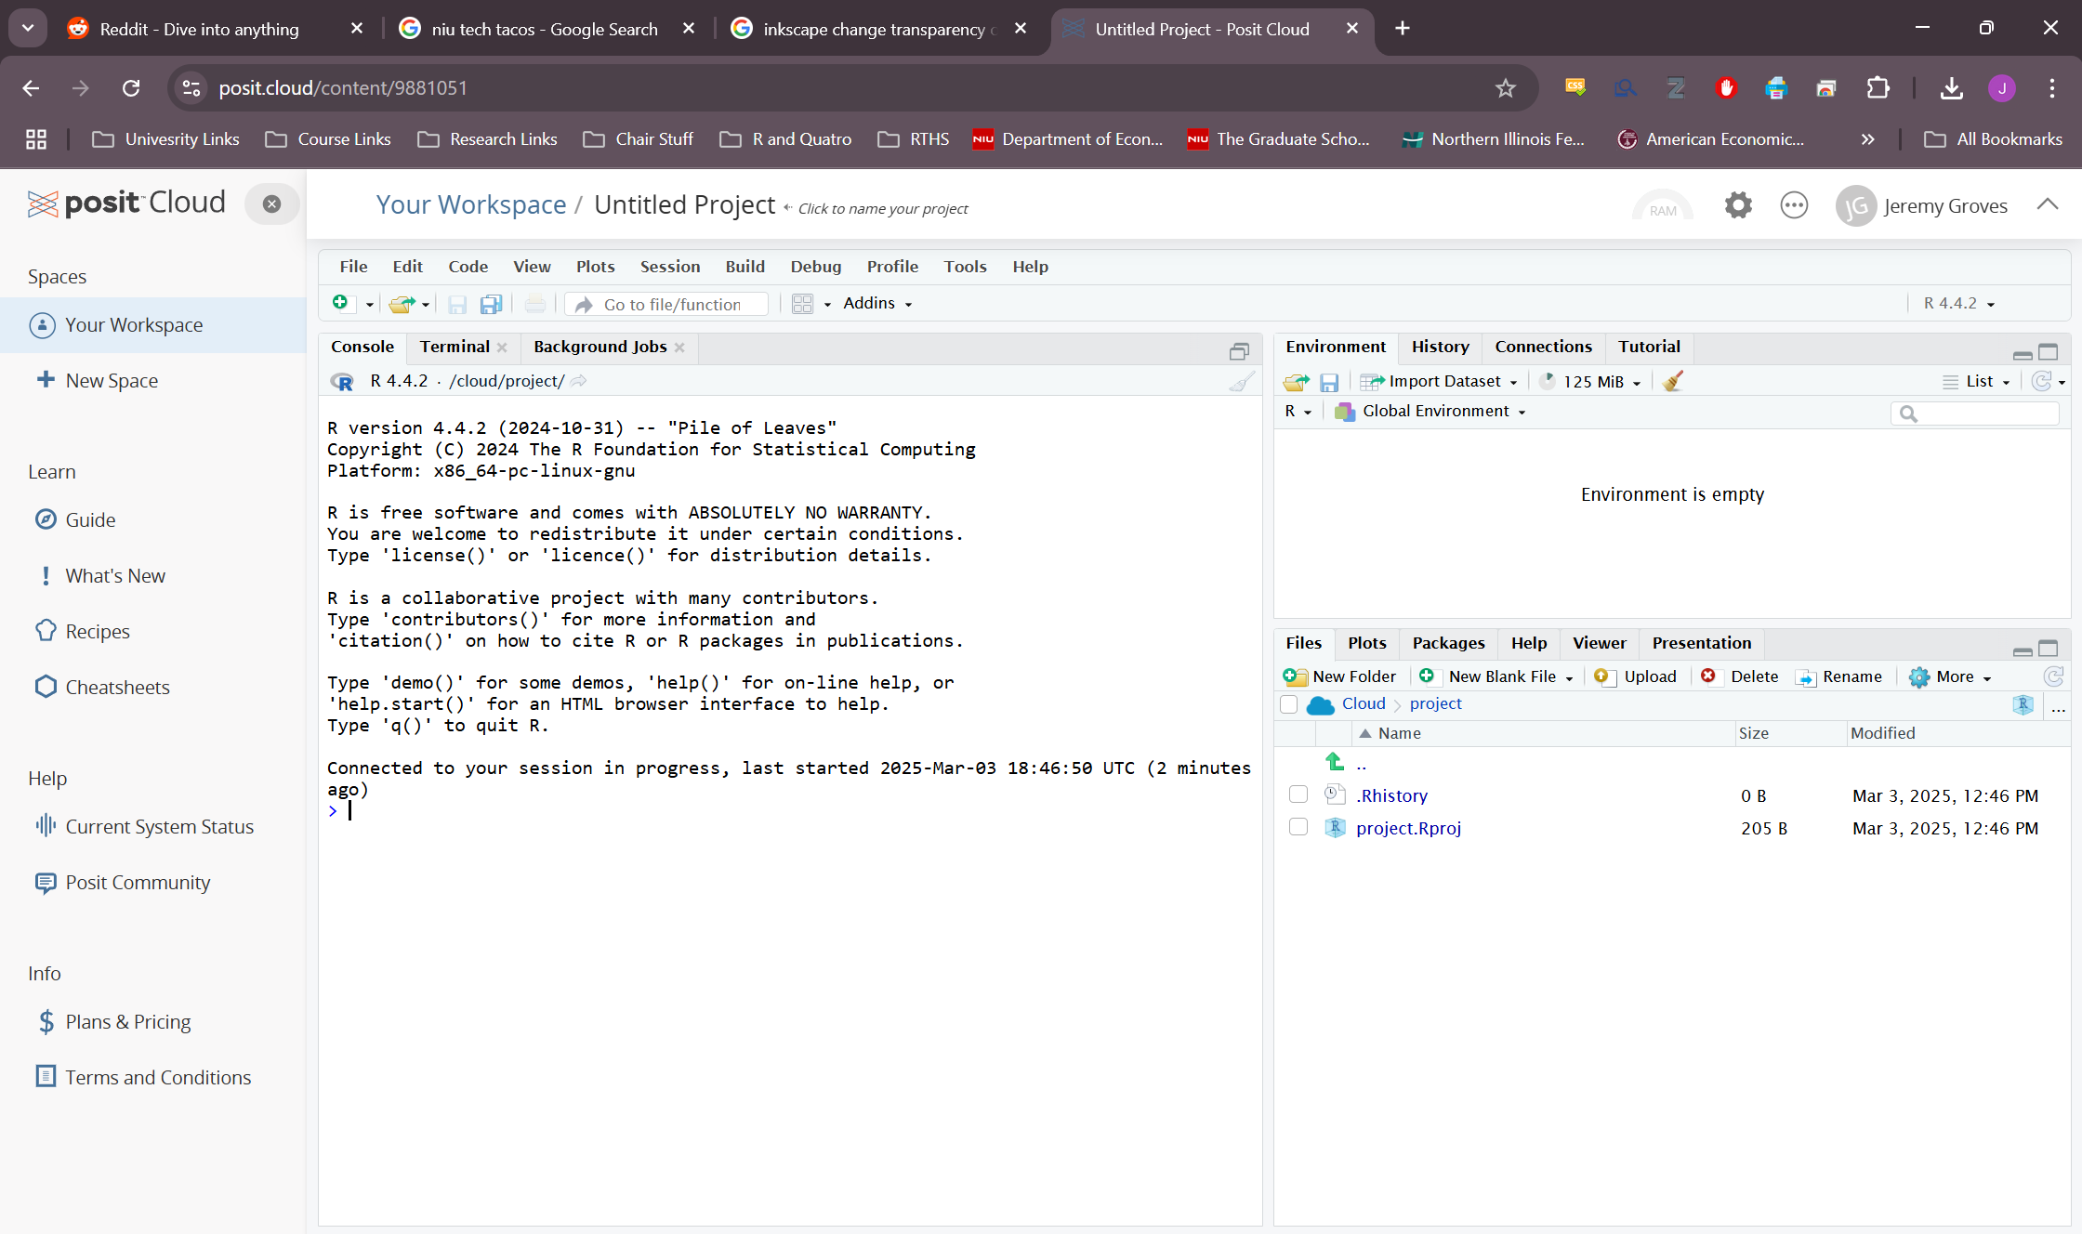
We will use the POSIT cloud which students can log into free and create a project so that they can use the R-Studio interface.
Go To: https://posit.cloud/
Create an account (using any email)
Choose a New R Studio Project from the upper left corner.
When your project opens, you can get ahead a bit by typing in the following commands in the console in the left side.
install.packages(“tidyverse”)
install.packages(“sf”)
install.packages(“usethis”)

Slide 3

Our Mission
Our mission is to visualize the percentage change in the number of UFO sightings per person in the continental U.S. between 1990 and 2010.

Slide 4
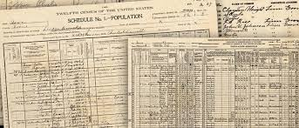

The Chips and Salsa Appetizer
The first key issue is getting data. Data can come from three main sources:
Original Collection. This may be going out and measuring something or collecting information or may simply be the transfer of archival data from print to digital formats.

Slide 5
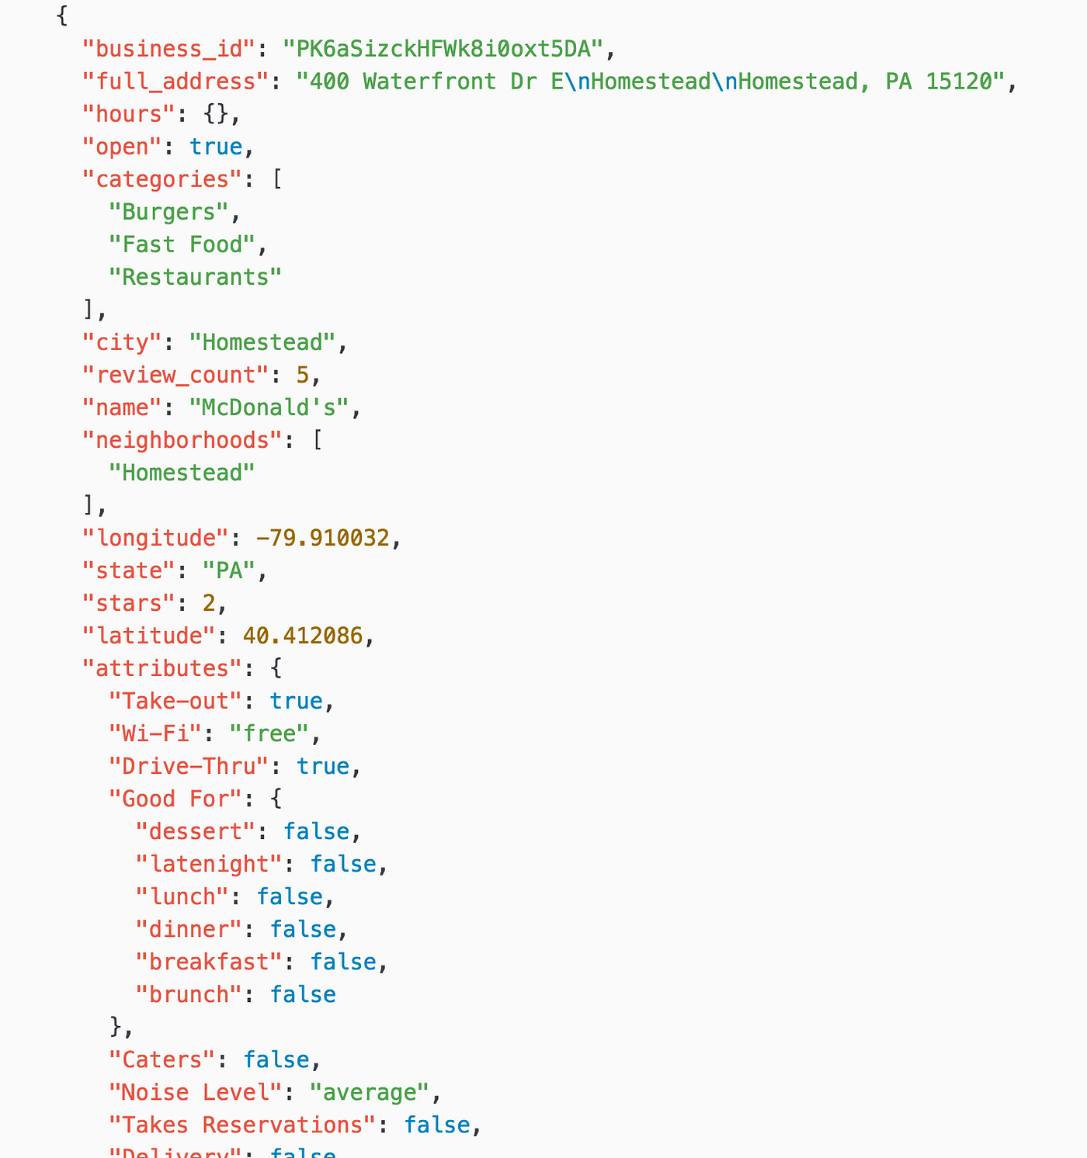
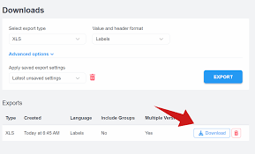
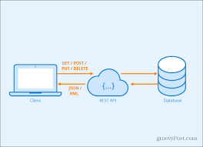
The Chips and Salsa Appetizer
Downloads: This can include data from a primary source such as Redfin or Zillow for housing data, from an API source such as a government or industry database/website, or from cloud storage such as OneDrive or GitHub.

Slide 6
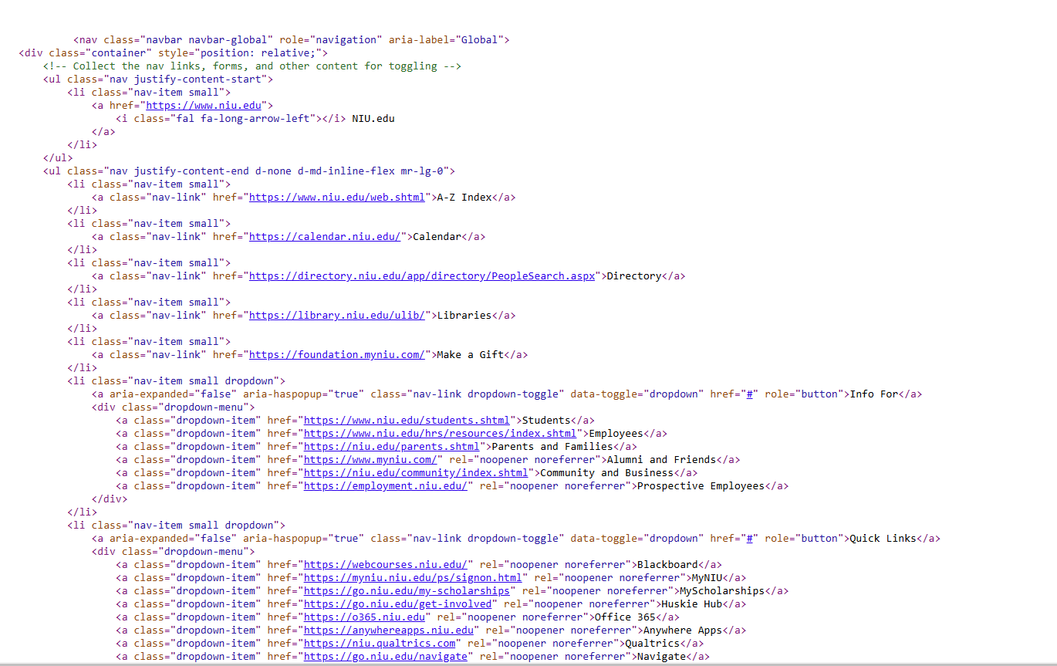
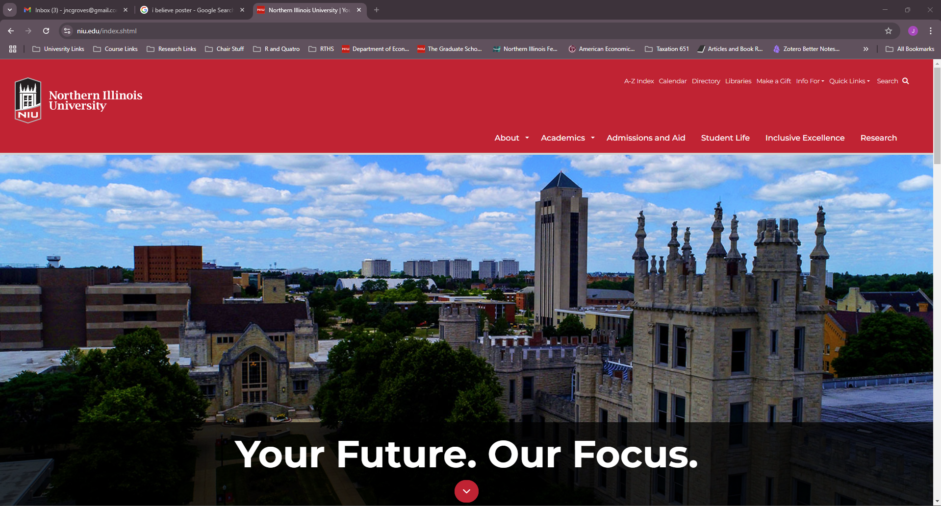
The Chips and Salsa Appetizer
Scrape It: Web-scaping is the process of exploiting the fact that websites, as pretty as they might be, are still just a code written on a system according to a language.

Slide 7
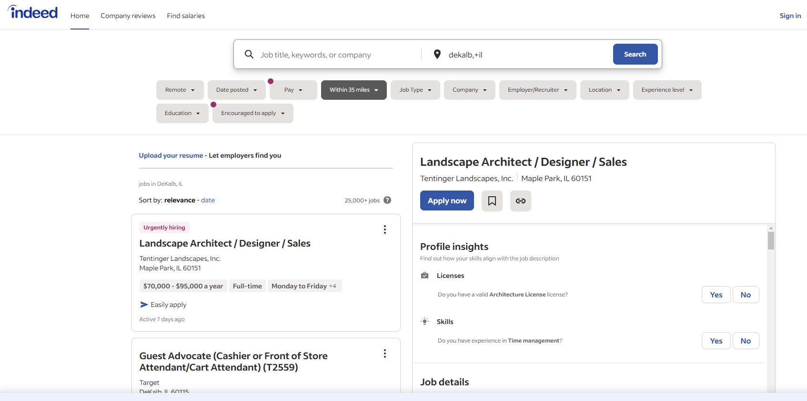
The Chips and Salsa Appetizer
Scraping is great if you want to pull lots of data off a website rather quickly. Typical scraping code will simply read the HTML file into memory and then look for certain key words or look in specific locations (“Xpath, JSpath, etc.). Chrome’s “Inspect Page” and some add-ins will help location the necessary address.

Slide 8
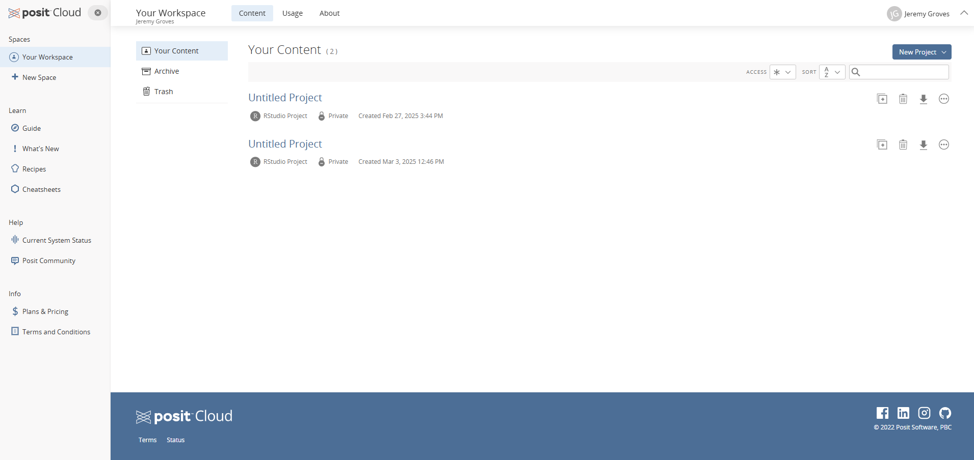
The Main Course

